Slide 1


Slide 2
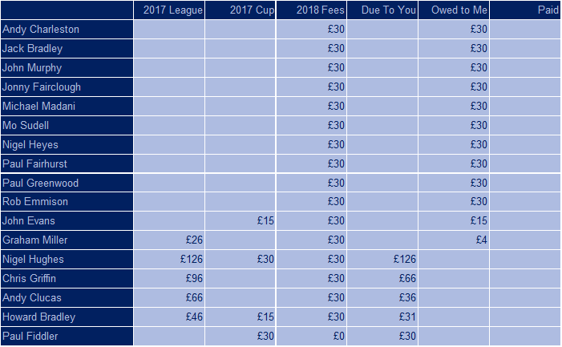
DL 2017/18 Money

Slide 3
DL 2018 Schedule

Slide 4
DL 2018 Auction Night

Slide 5
DL 2018 Mop-up Auction
Leave here with a minimum formation of 1-2-3-5
Email Mop-up auction start tomorrow, deadline 5pm Sunday 10th
Maximum of 18 players - assume you will win every bid so do not exceed squad numbers or remaining funds
Round 1 – Absent managers, unsold ABC players only
Round 2 – All managers, unsold ABC and Cat D players
Defenders are as follows…

Slide 6
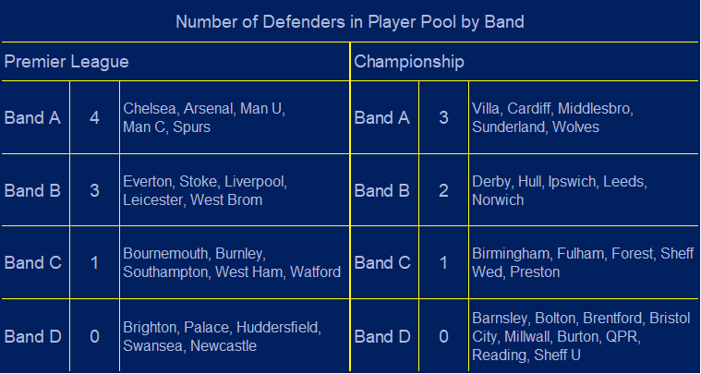
DL 2018 Defenders

